Slide 1




lv zero
Arrays & Strings
session 02
prepared by : Omar Ali
Salma Hafez
ICPC
MANSOURA

Slide 2



Who am i
intro

Slide 3
Who am i
1
Technical In ICPC Mansoura
2
Data science supervisor, CAT Reloaded
intro
3
CCSED LEVEL 300
4
Conan big fan

Slide 4


lv zero
1
1D Arrays
Agenda
2
Frequency Array
3
Multi-D Arrays
4
Strings
5
Built-In Fucntions

Slide 5

Read 3 numbers and print them in reverse order
int a1, a2, a3;
cin >> a1 >> a2 >> a3;
cout << a3 << a2 << a1 ;
Easy Challenge

Slide 6
Read 3 numbers and print them in reverse order
int a1, a2, a3;
cin >> a1 >> a2 >> a3;
cout << a3 << a2 << a1 ;
Easy Challenge
Read10 numbers and print them in reverse order
????????

Slide 7
Read 3 numbers and print them in reverse order
int a1, a2, a3;
cin >> a1 >> a2 >> a3;
cout << a3 << a2 << a1 ;
Easy Challenge
00
Read10 numbers and print them in reverse order
????????

Slide 8

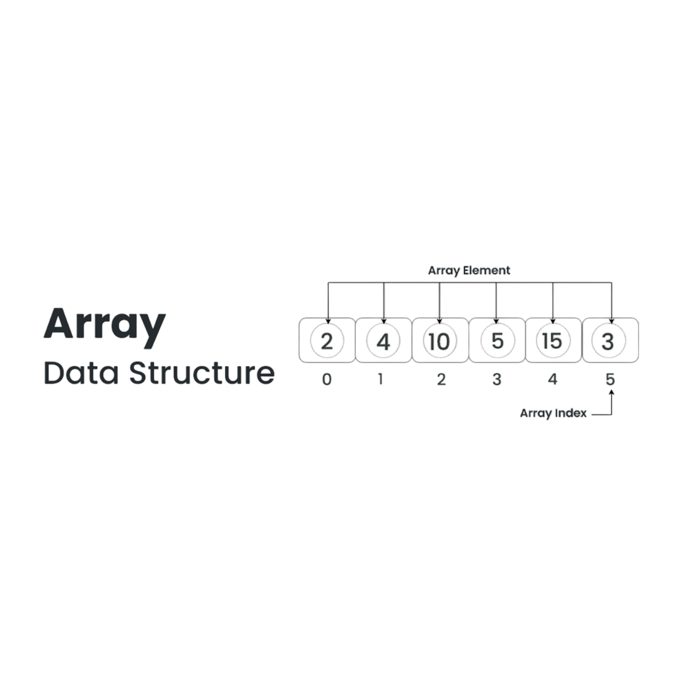
Data_Type Arr_Name [Arr_Size];
int arr[6];

Slide 9

Initialization
int arr[5]= {1, 2, 3, 4, 5};
char arr[4]= {‘I‘, ‘C‘, ‘P‘, ‘C‘};

Slide 10
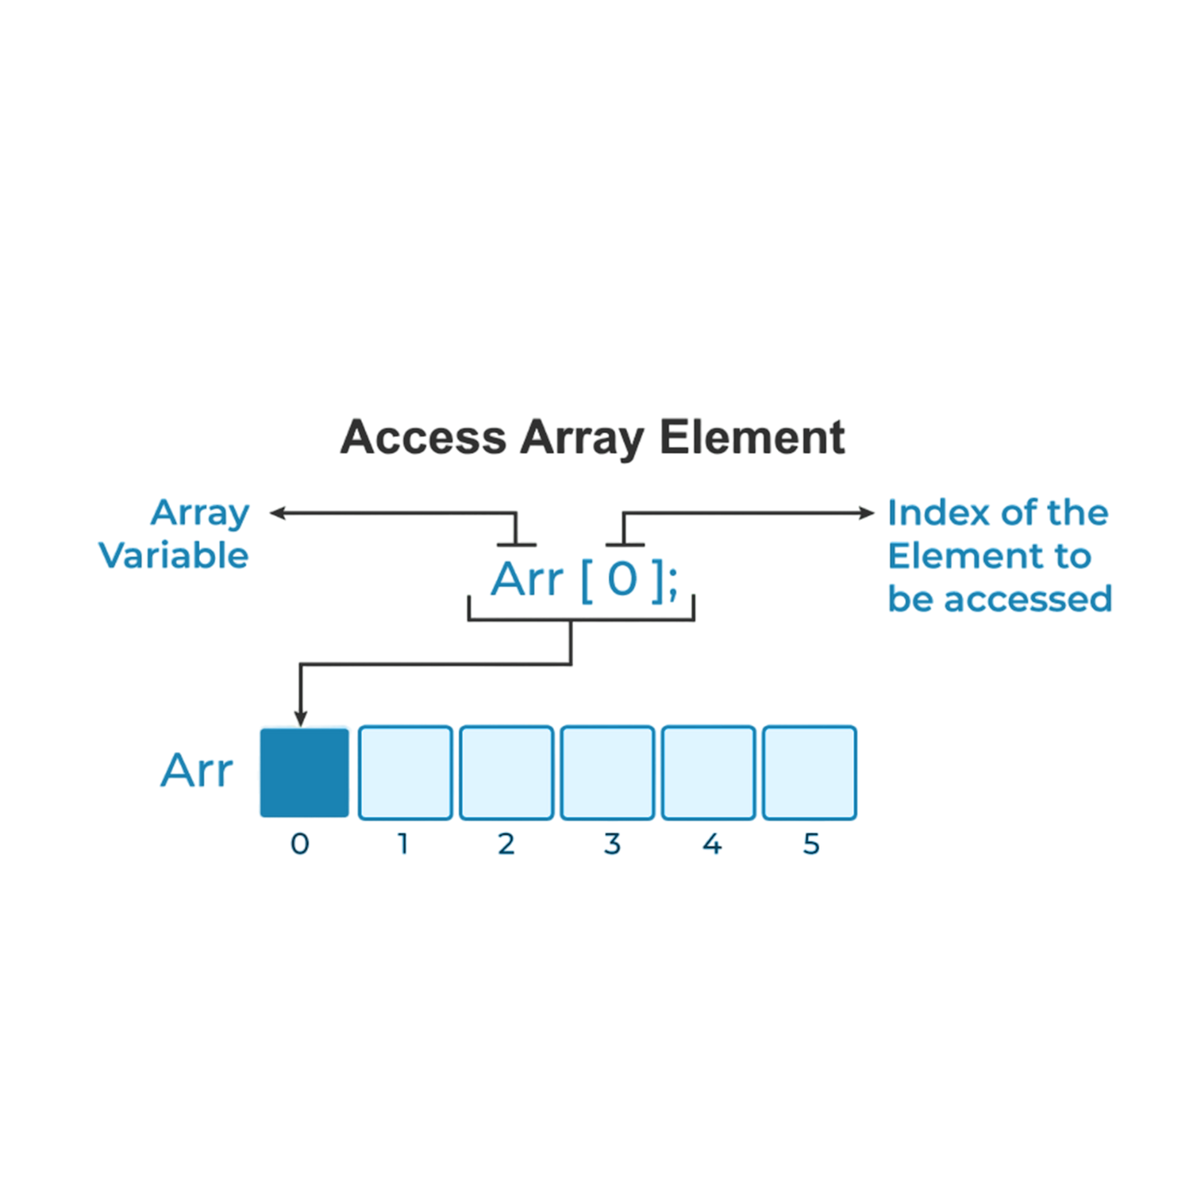
Initialization
int arr[5]= {1, 2, 3, 4, 5};
char arr[4]= {‘I‘, ‘C‘, ‘P‘, ‘C‘};

Slide 11
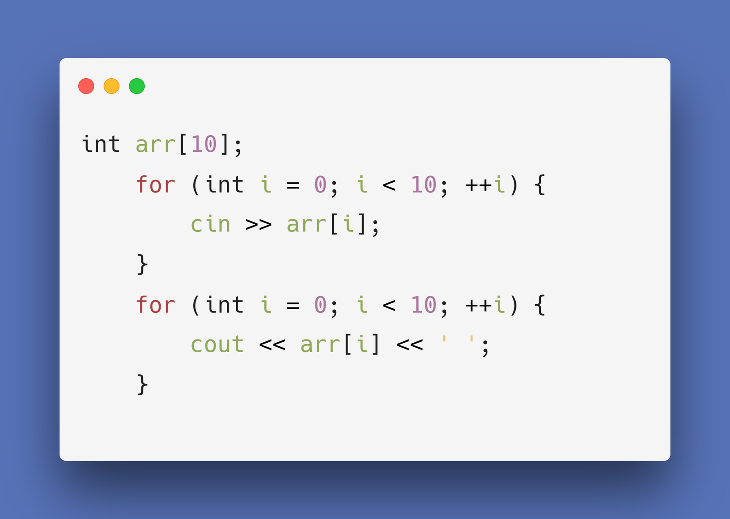


Slide 13
coding time

Slide 14
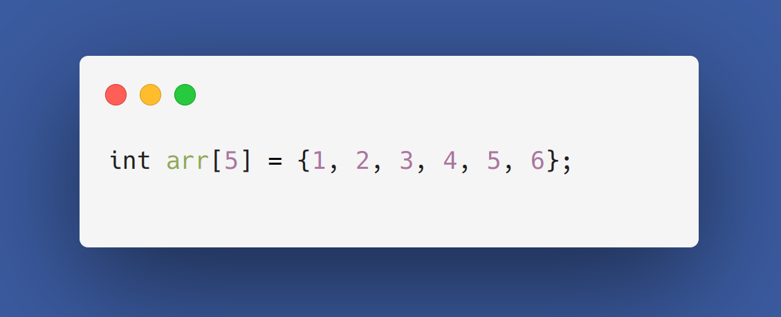

GUESS
THE OUTPUT

Slide 15
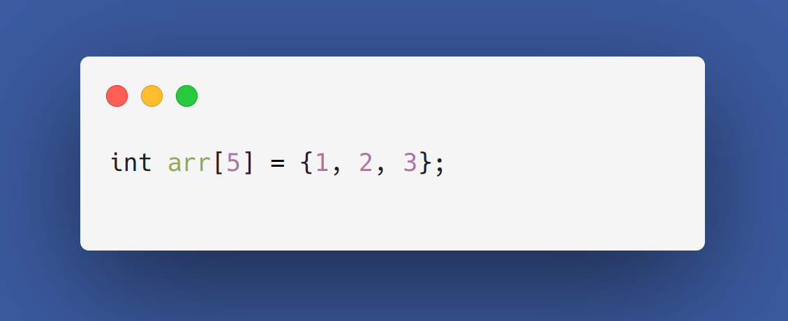
GUESS
THE OUTPUT

Slide 16

GUESS
THE OUTPUT

Slide 17

GUESS
THE OUTPUT

Slide 18
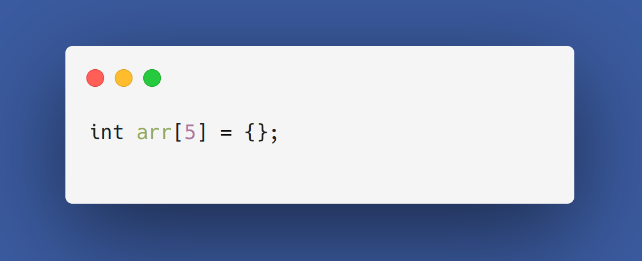
GUESS
THE OUTPUT

Slide 19





CORRECT
WRONG
declare array
with big size
global
// 10^8 maxsize
Access elements out of bounds
if it local initialize it by zeros.
// 5 * 10^5 maxsize
negative index , index > size - 1

Slide 20

Problem
3B3ZIZ CHALLENGED SAMER TO TAKE N NUMBERS AND DISPLAYS 2 LINES : FRIST LINE CONTAINS EVEN NUMBERS AND THE SECOND LINE CONTAINS ODD NUMBERS (0 < N < 1000)

Slide 21


built in
functions

Slide 22



Built In Func
#include <algorithm>
#include <bits/stdc++.h>
SIZEOF
?
?
?
?

Slide 23
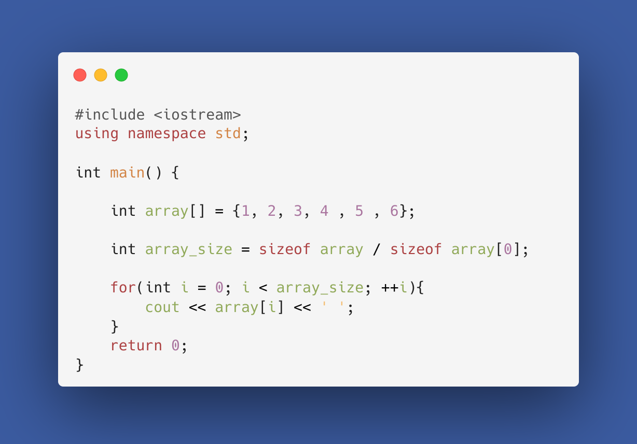

Slide 24
Built In Func
#include <algorithm>
SIZEOF
SWAP
?
?
?
swap arrays & elements

Slide 25
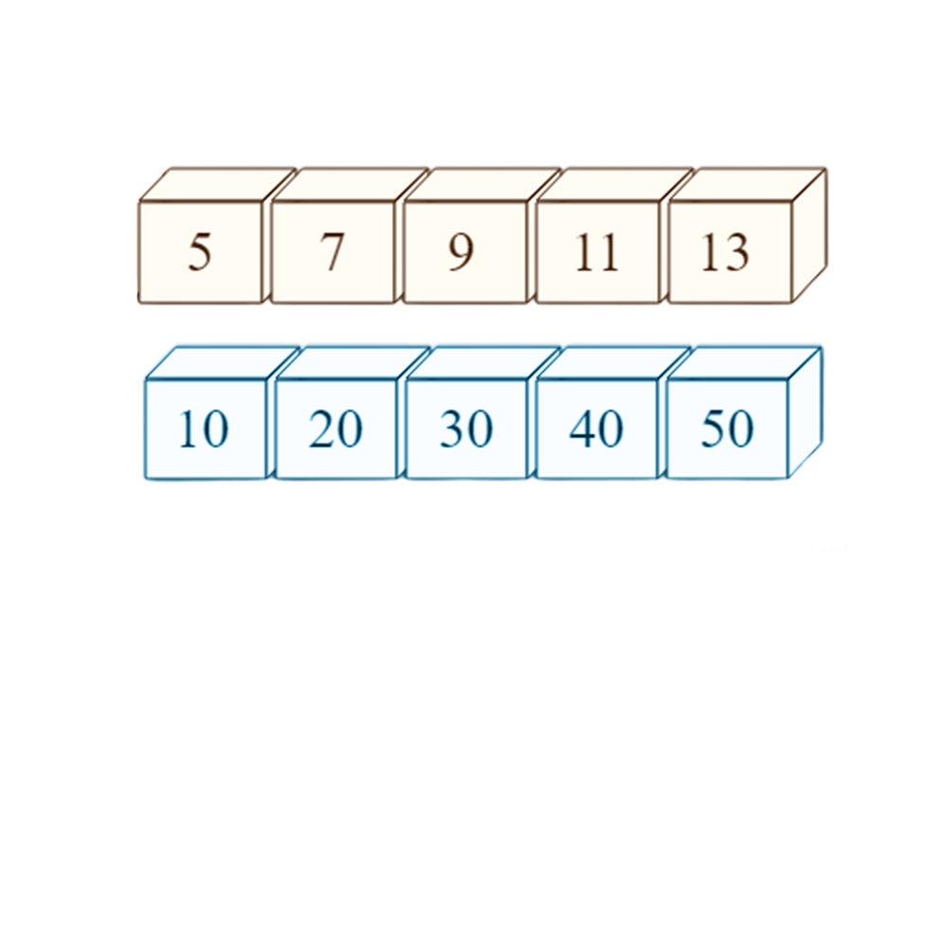
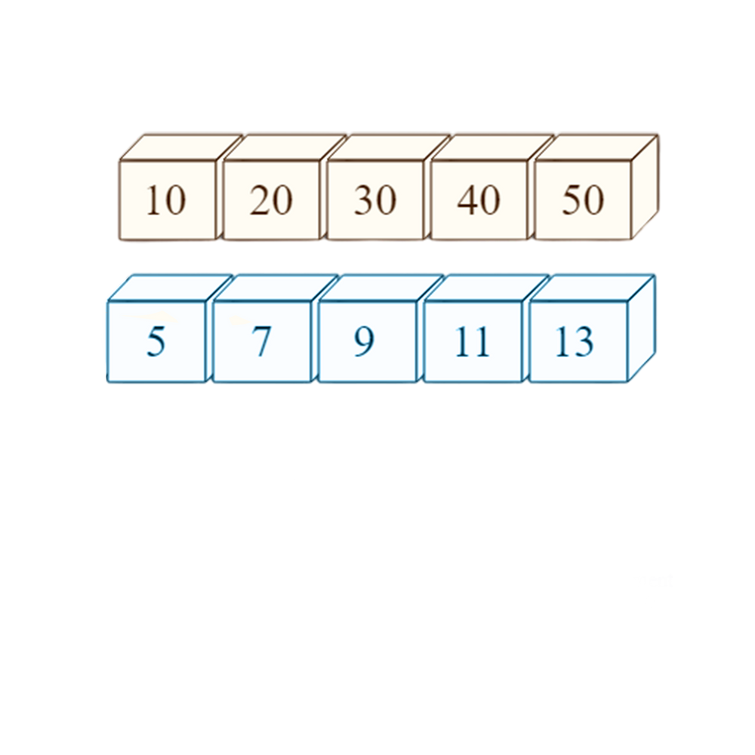


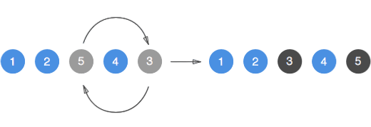
swap(arr1,ar﻿r2)
swap(arr1[2],arr1[4])
swap

Slide 26
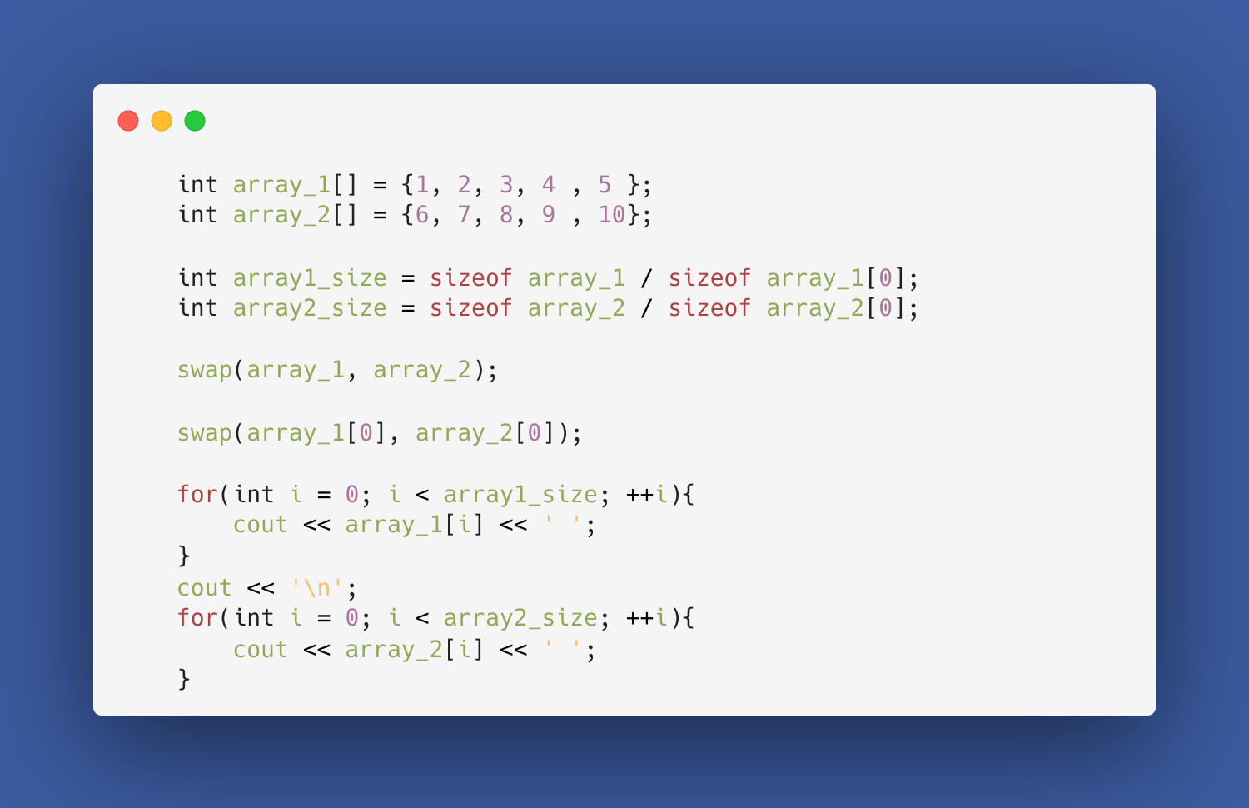

Slide 27
Built In Func
#include <algorithm>
SIZEOF
SWAP
SORT
?
?
swap arrays & elements
ASCENDING &
DESCENDING

Slide 28
sort(arr, arr + n)
sort(arr, arr + 5)
sort(arr + 2, arr + 7)
sort(arr, arr + n, greater<int>())
Where n is size of array
sort

Slide 29
Built In Func
#include <algorithm>
SIZEOF
SWAP
SORT
REVERSE
?
swap arrays & elements
ASCENDING &
DESCENDING

Slide 30
reverse
reverse(arr, arr + n)
reverse(arr, arr + 5)
Where n is size of array

Slide 31
Built In Func
#include <algorithm>
SIZEOF
SWAP
SORT
REVERSE
MIN-MAX
swap arrays & elements
ASCENDING &
DESCENDING

Slide 32
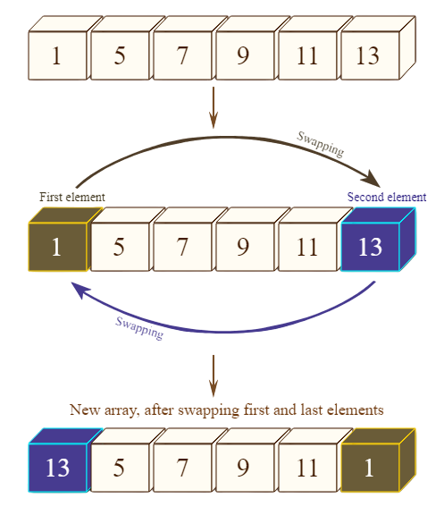

min
*min_element(arr, arr + n)
1
*min_element(arr, arr + 4)
5

Slide 33
max
*max_element(arr, arr + n)
13
*min_element(arr + 1, arr + n)
11

Slide 34

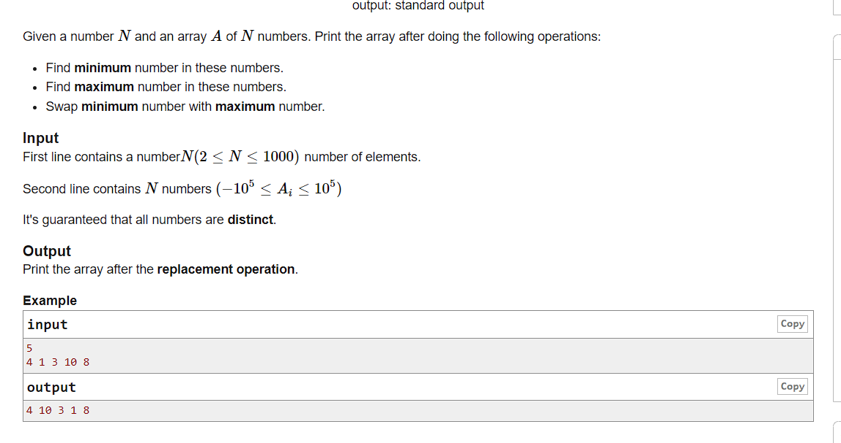
problem
PROBLEM
LINK
SOLUTION

Slide 35
solution

Slide 36
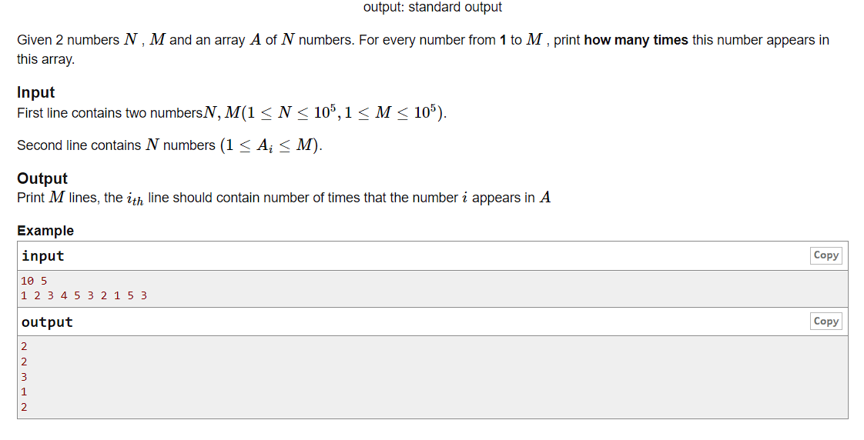
problem
PROBLEM
LINK

Slide 37
FIRST
SOLUTION
solution

Slide 38
frequency array

Slide 39
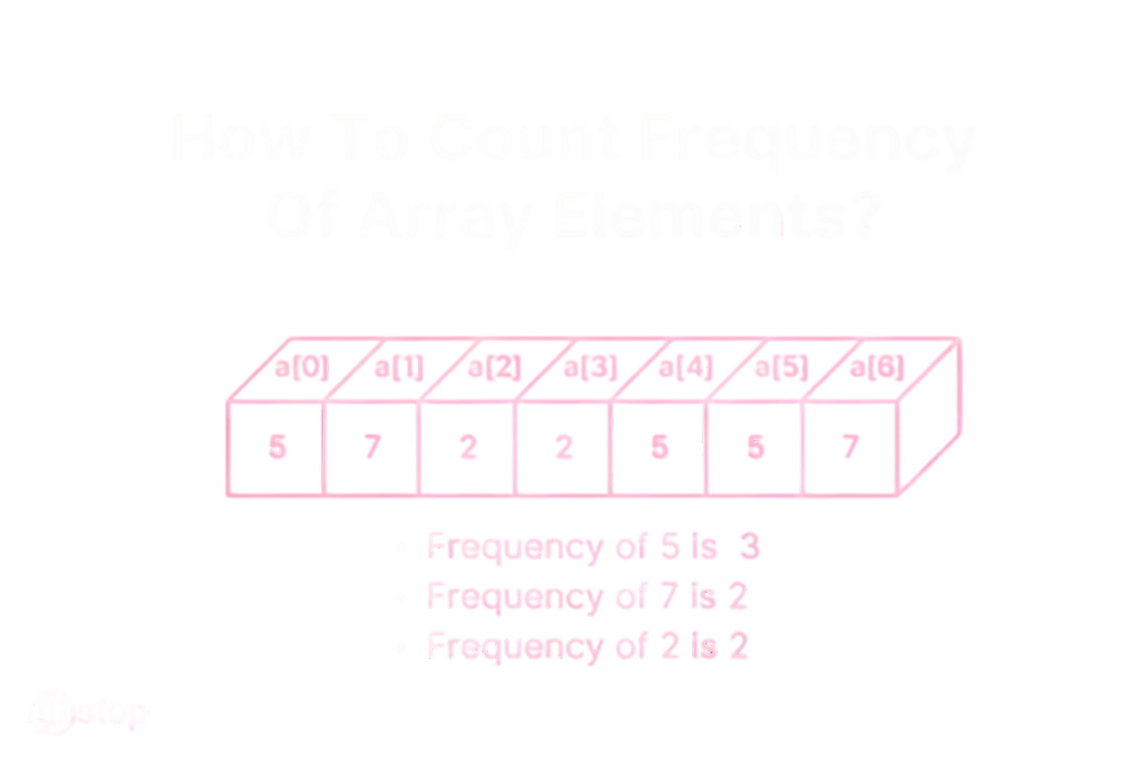

input
our solution
0 0 0 0 0
1 1 1 1 1 1 1
2 2
3 3
4 4 4 4 4
5 5 5 5 5
6 6 6 6 6 6 6
frequency of 0 = 5
frequency of 6 = 7

Slide 40
CORRECT
SOLUTION
solution

Slide 41



Multi-Dimensional array

Slide 42
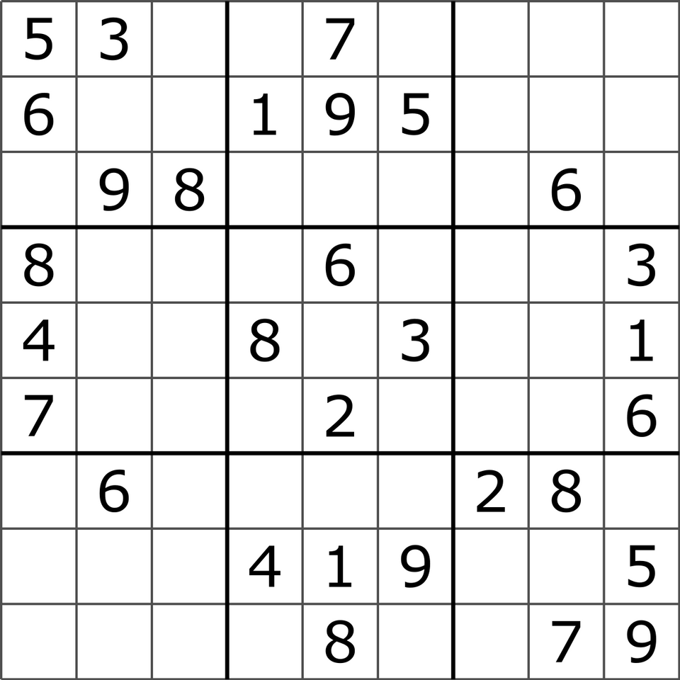
What if we want to represent 9*9 sudoku board?
We can create 9 arrays of size 9.
int row_1[9];
int row_2[9];
int row_3[9];
…………….
int row_9[9]; ????

Slide 43
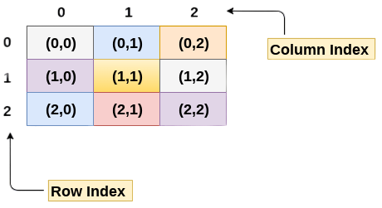
int arr[3][3];

Slide 44
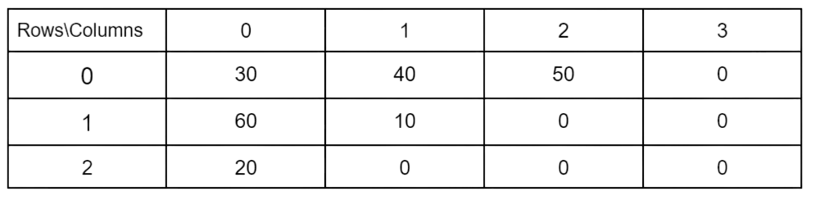
int arr[3][4]= {{30, 40, 50},{60, 10},{20}};

Slide 45
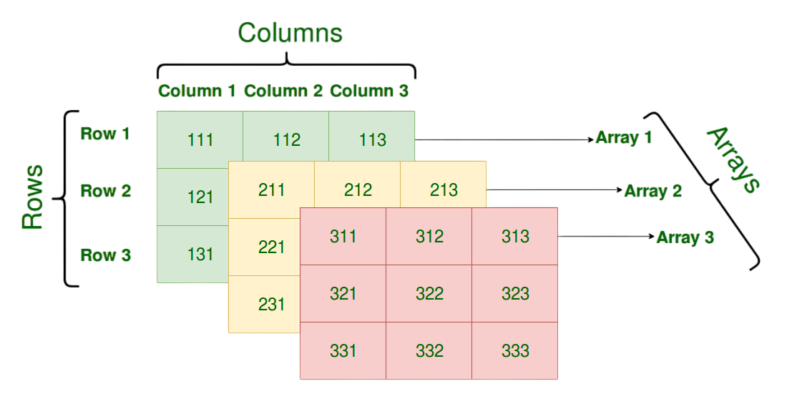
int arr[3][3][3];

Slide 46
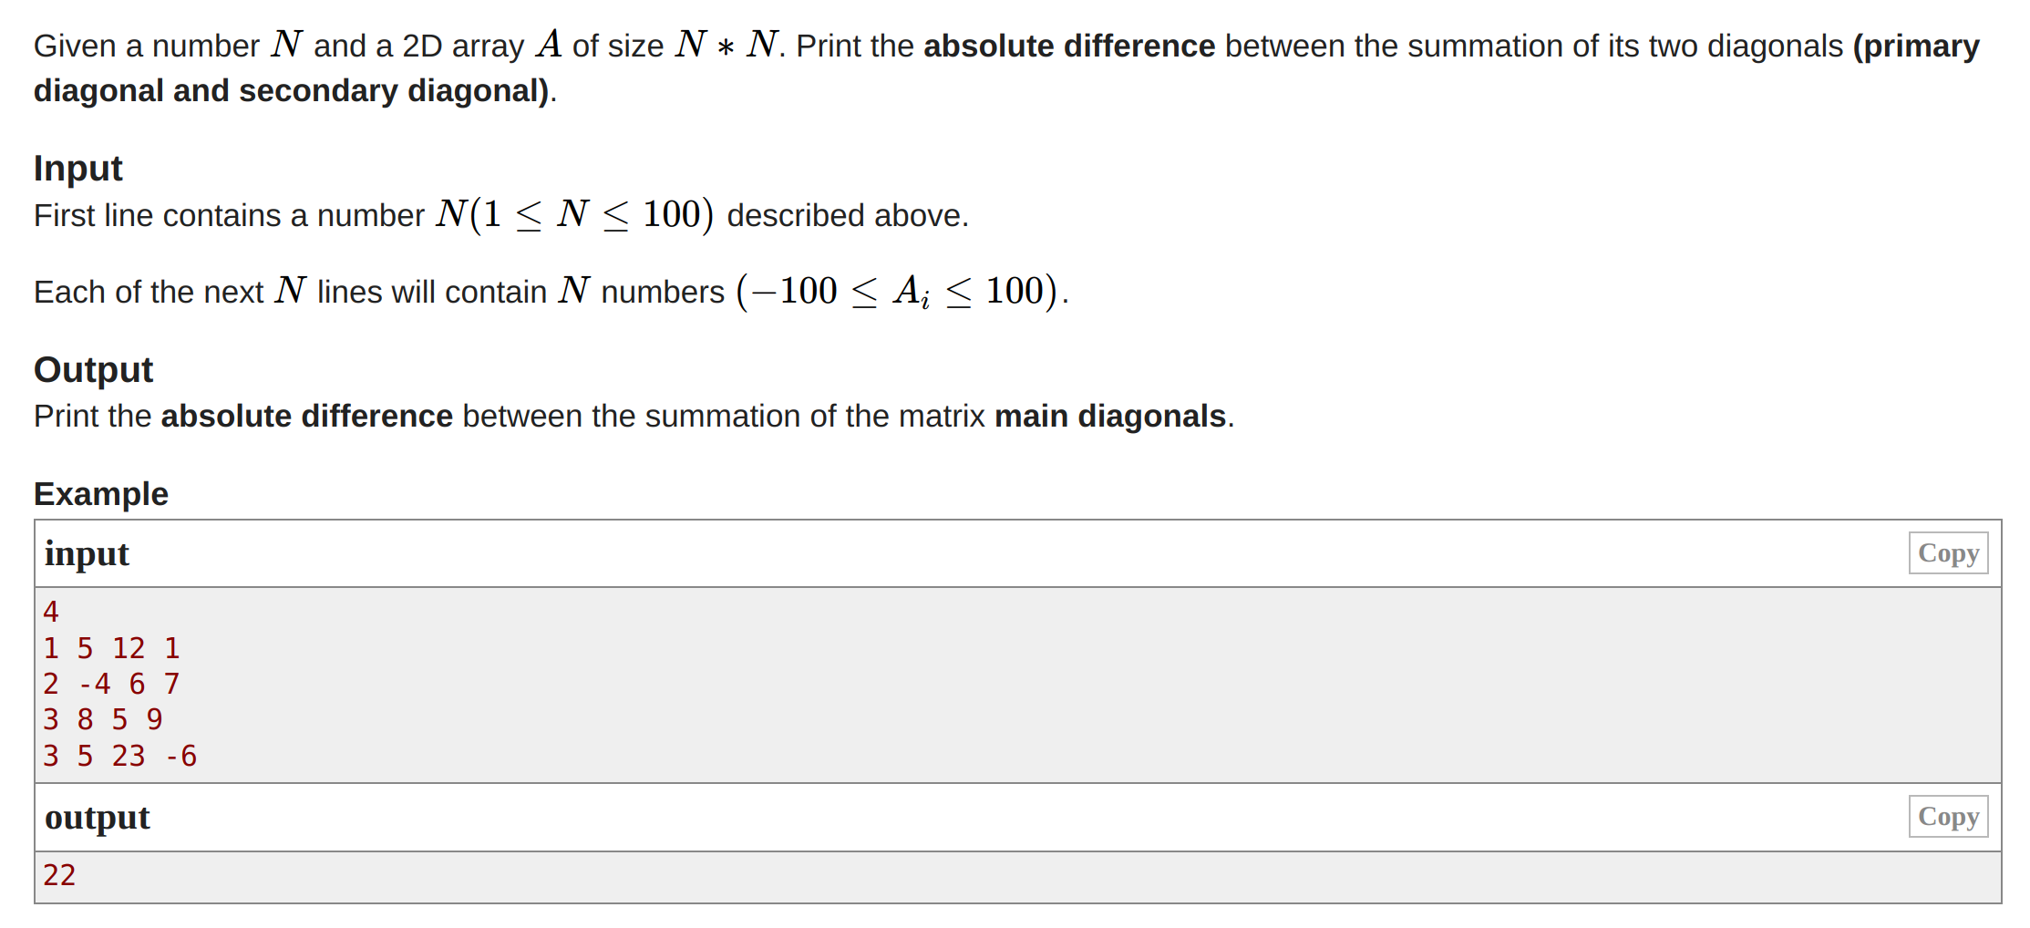
problem
PROBLEM
LINK
SOLUTION

Slide 47

Break time

Slide 48

string

Slide 49
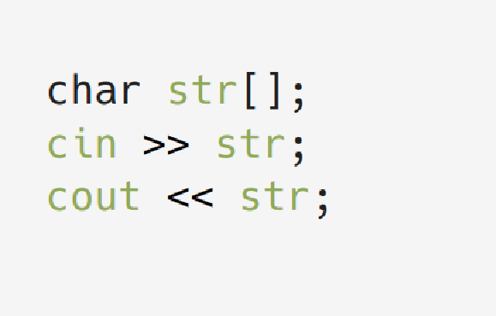
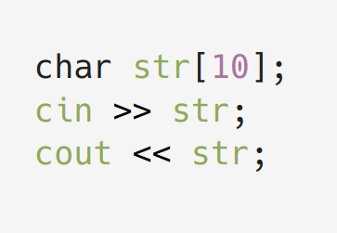
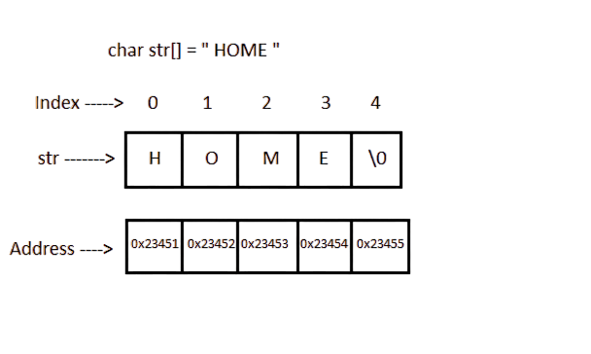

Slide 50
DEFINITION
INITIALIZATION
STRING
string str = “”;
string str = “Hello”;
String is typically
array of characters
ACCESS ELEMENT
DECLARATION
by index
ex : s[2]
char variable_name [length];
string variable name;

Slide 51
concatenation
// CONCATENATING 2 STRINGS string a = “Hello” string b = “World” string c = a + b; cout << c; // “HELLOWORLD”
// CONCATENATING MORE THAN 2 STRINGS C = A + “ “ + B; cout << C; // “HELLO WORLD”

Slide 52
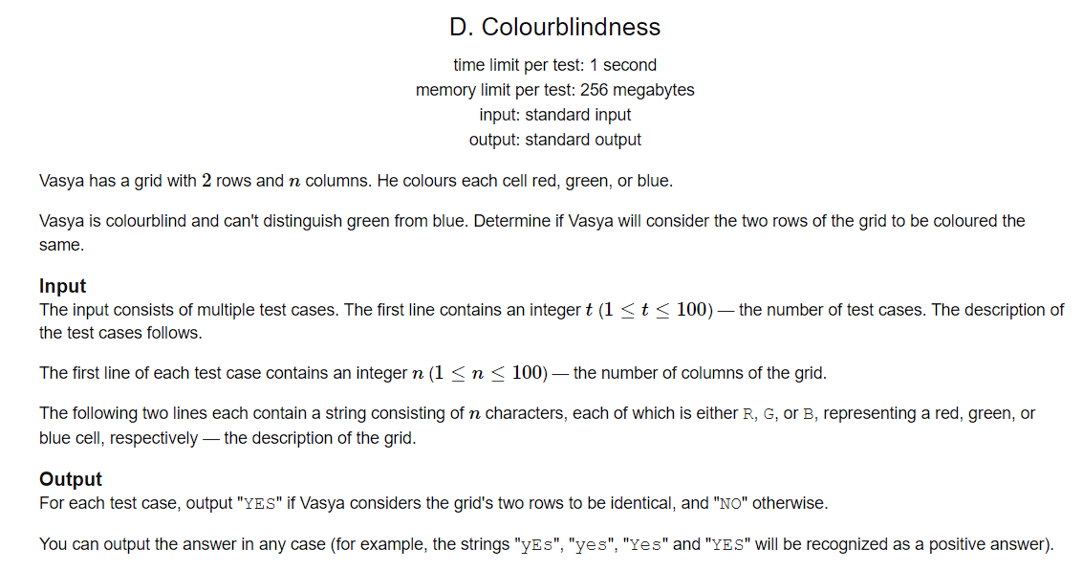
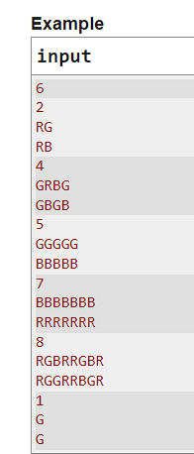
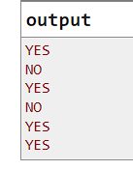
problem
PROBLEM
LINK
SOLUTION

Slide 53

sort()
size()
// sort string in asc/dec order
sort(str.begin(), str.end());
// get the size of the string
int len = str.size();
magic
reverse()
swap()
STRING
// reverse the string
reverse(str.begin(), str.end());
// swap two strings
string a = "Hello";
string b = "World";
a.swap(b);
getline()
clear()
// get a phrase as an input rather than only one word
string str;
getline(cin, str);
// clear the string
str.clear();

Slide 54
substr()
erase()
// slice string
str.substr(position, length)
// erase one or more than
one char from string
string str = "Hello, World!";
str.erase(7, 7);
magic
find()
insert()
STRING
// search for a substring
string str = "Hello, World!";
size_t pos = str.find("World");
// insert substring into string
str.insert(position, string)
push_back()
pop_back()
replace()
// add - remove char
to the end of the string
string str = “Hello";
string.push_back(‘o’);
string.pop_back();
// replace one or more than one char in string
str.replace(position, length, string);

Slide 55
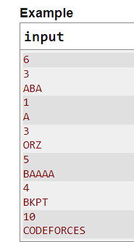
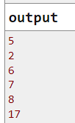
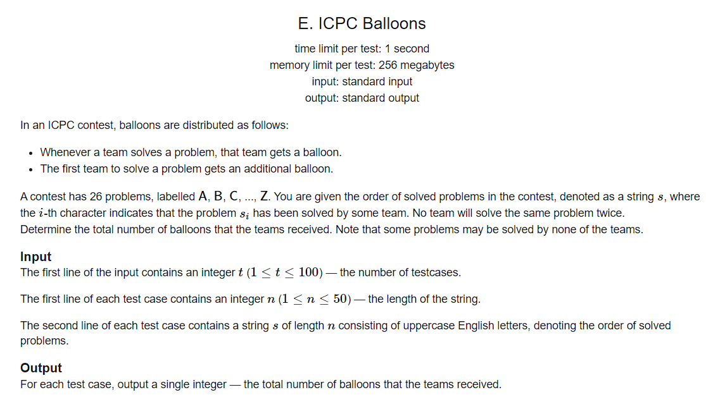
problem
PROBLEM
LINK
SOLUTION

Slide 56
coding time

Slide 57

thank you

